Slide 1
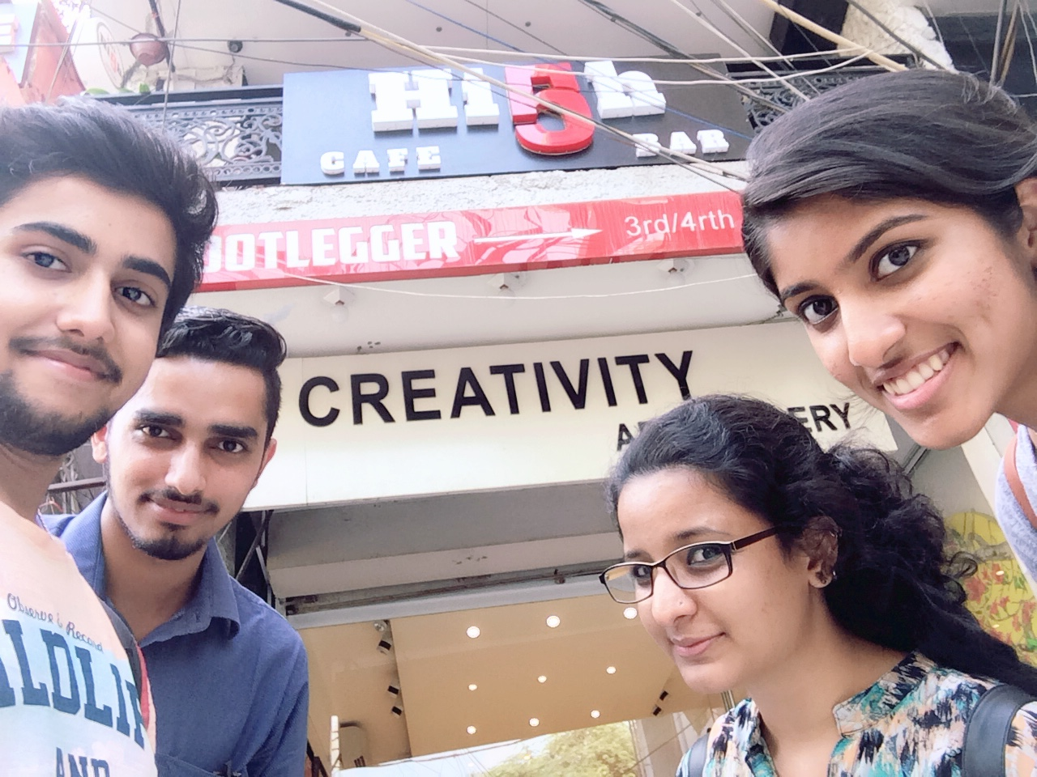
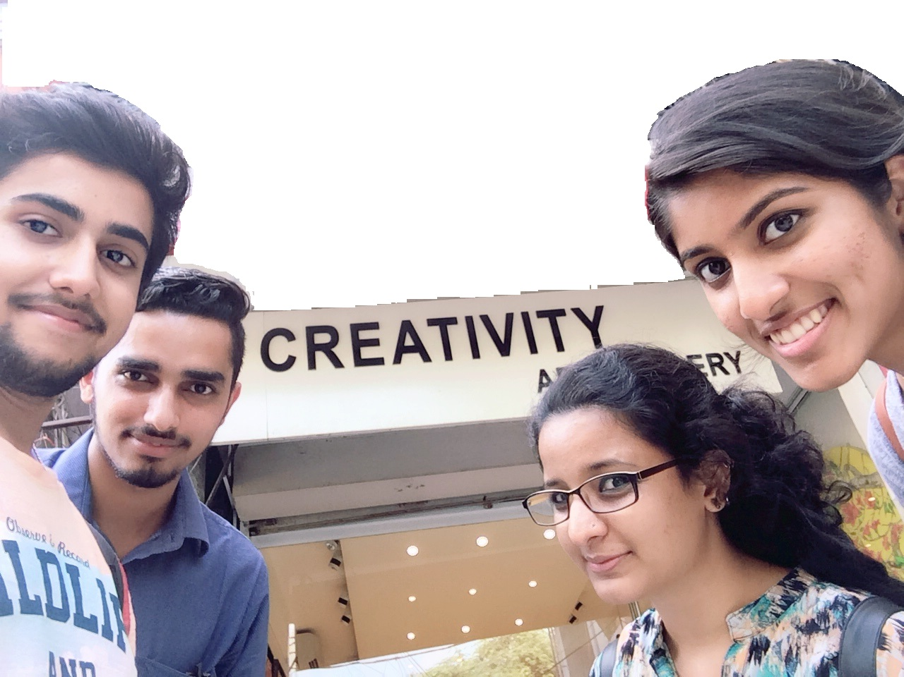
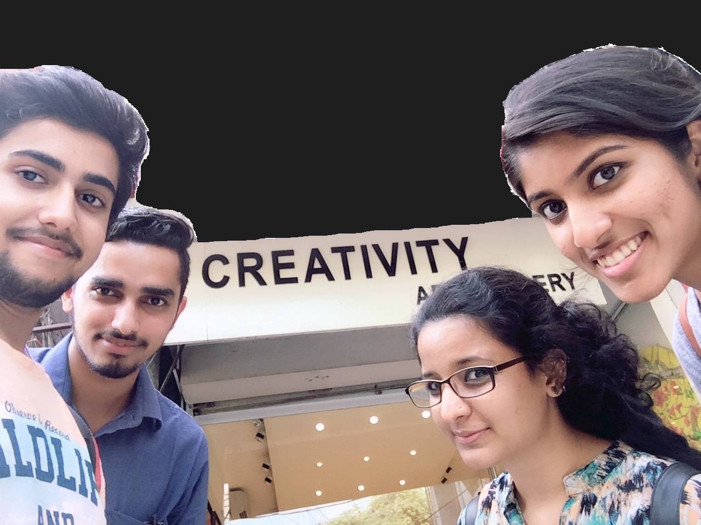
‘belzzibub’ GROUP1 NCAT CEP 2014
SHUBHANKAR
GUPTA
THE
SPOOFS!!!
NADIMPALLI
VINEETHA
G
R
O
U
P
4
SHIVANGINI
KOTIYAL
GURPREET
SINGH
Department of Management Studies
IIT Delhi
30th June – 4th July, 2014

Slide 2
TOP 3 CREATIVE IDEAS
PediCharger
Parking Locator
Smart Auto Card

Slide 3
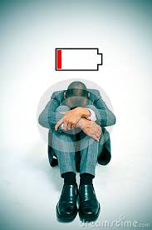
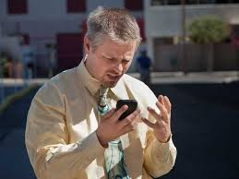
THE PAIN AREA
Everyone needs a portable charger even those who can not afford one because the need and use of electronic devices is more frequent in daily routine now a days.

Slide 4
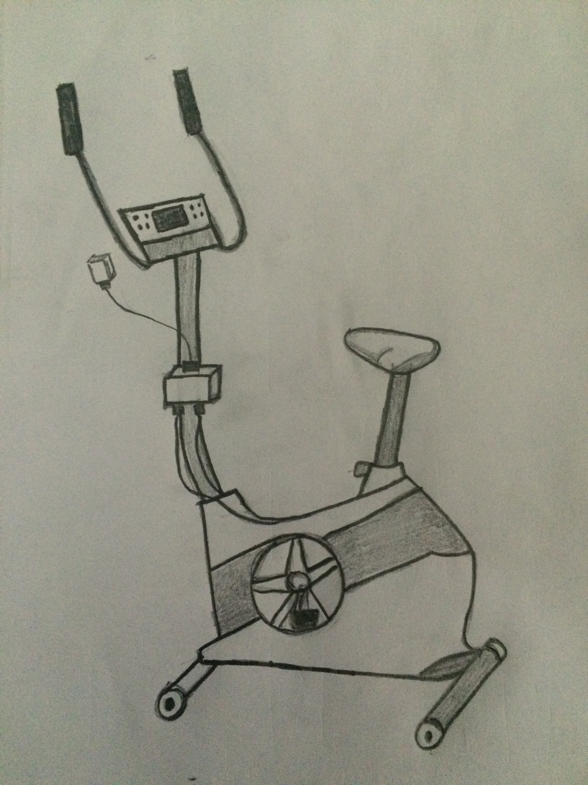
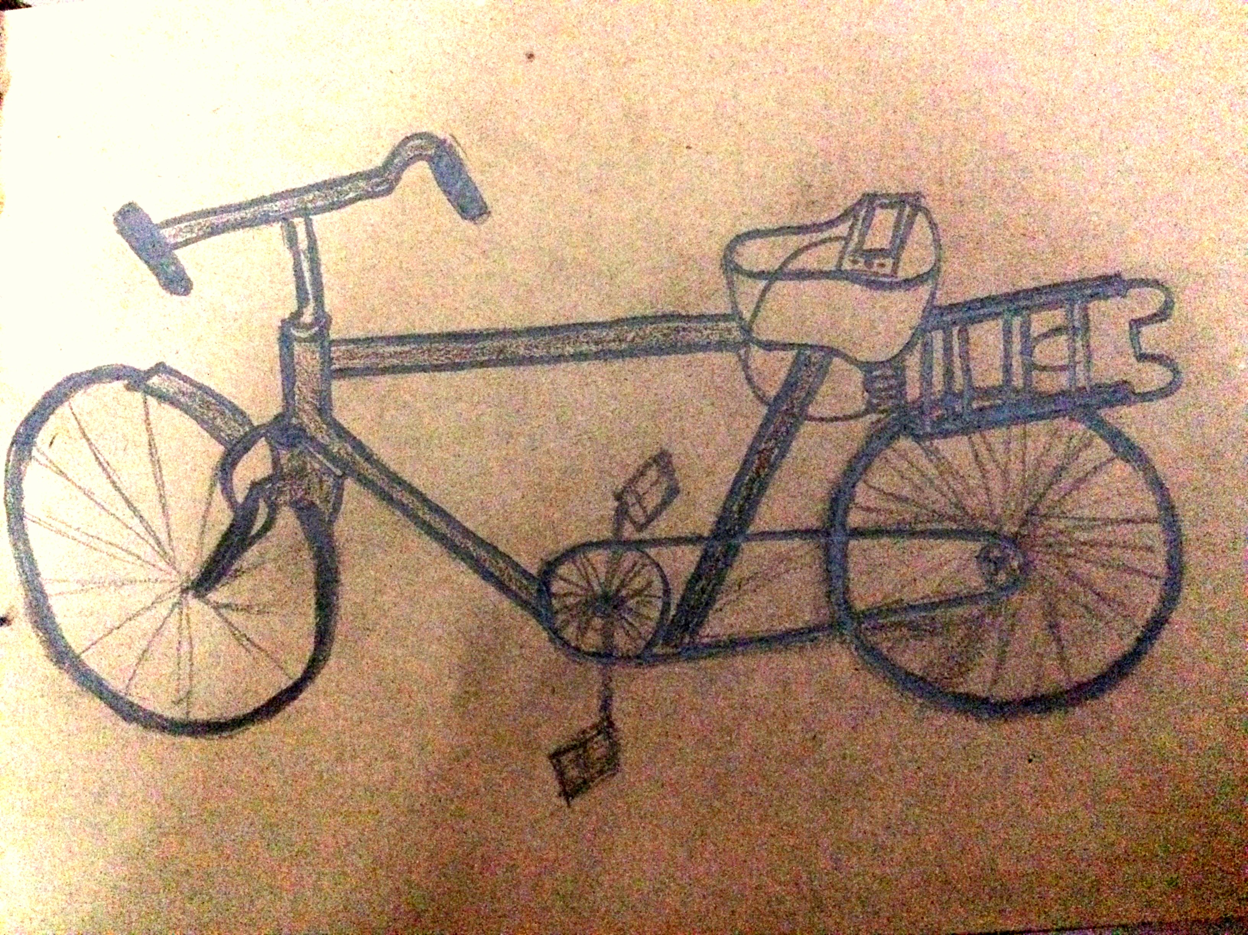
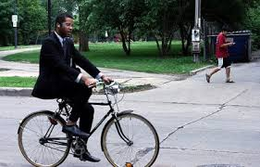
PediCharger
In today’s mobile crazy world, where people spend more time on their smart phones, smart devices than what they spend with other people…
We know, SMART DEVICES need CHARGE, when we are on the run with the fast pacing world.

Slide 5
IMPACT
On people
On market
People from areas where electricity is an issue (21.3%), this will be the solution for their charging problems.
This product will act as a best friend to those who use bicycle on daily basis.
This is an innovative way of charging which will also be beneficial to health if implemented by government to public gardens or areas.
According to Google, 960 million people uses electronic devices like mobiles, cameras, etc. This could be a huge help to those who need immediate charging of their devices.
PediCharger is an eco-friendly product.
Also affordable and easy to install.

Slide 6
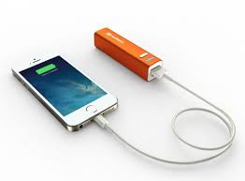
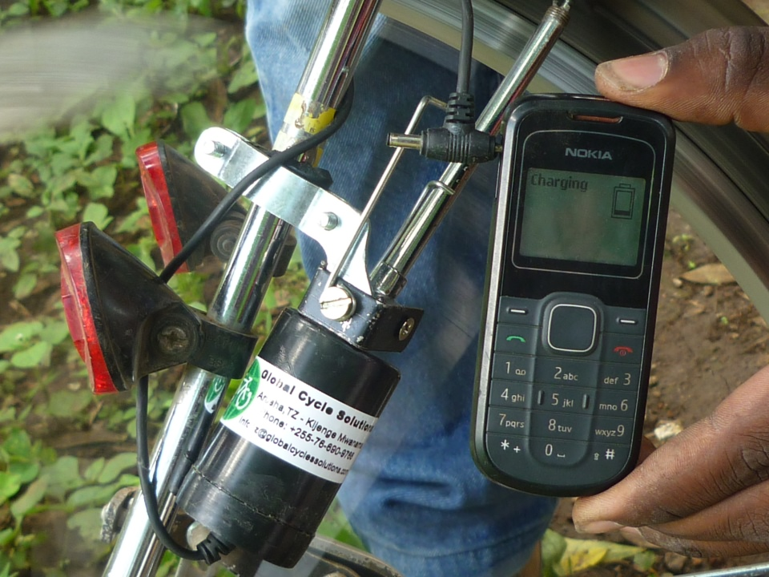
COMPETITION WE OVERCAME
Portable.
Less capacity.
Electricity dependent.
Private access.
Expensive.
Portable.
Less awareness.
Limited usage.
Private access.
Portable.
Eco-friendly and Cheap.
Any device can be charged using USB Port.
Public as well as Private access.

Slide 7
THE 6 THINKKING HATS
More than 80% of people use electronic devices
Draining of battery due to frequent use of electronic devices around the clock
Existing solution not feasible for 2/3rd of existing solution
Eco-friendly
Minimal use of electricity
Low cost and portable
Accessible in rural as well as urban areas
If extended, promotes fitness
Productive use of mechanical energy into electrical energy
More effective and helpful portable charger
Can charge multiple devices( phone, camera )

Slide 8
Extends to the less privileged
Practically handicapped when battery is low/dead
Creates tension for loved ones
There are similar products which creates competition
Difficult to execute without government help
The charging rate depends on the paddling speed
Can be widely used in areas with minimal/no access to electricity
Useful in towns where cycles are used on daily basis
Time required to charge depends on mechanical energy produced

Slide 9
HELPING HANDS!!!
Financial Help
Marketing Help
Our product consists
Transducer ( costing around Rs. 800);
Charing Adapter ( costing around Rs.50-Rs.100);
USB Port and wiring ( costing around Rs.50).
Even government can adapt this idea and introduce it in public places.
Engineering help for building the mechanism.
Investors to implement our product into public areas like gardens, etc.
Government can implement this idea into rural areas.

Slide 10
STRATEGIC KNOW HOW!!!
How much minimal amount of energy will be required by the bicycle to attain the circuit's need.
The design of the product has to be modified according to the requirement.
Understanding of the maintenance of the arrangement.

Slide 11
QUESTIONS???

